Slide 1
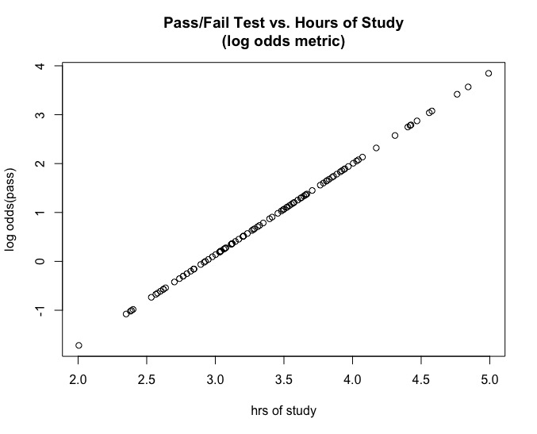
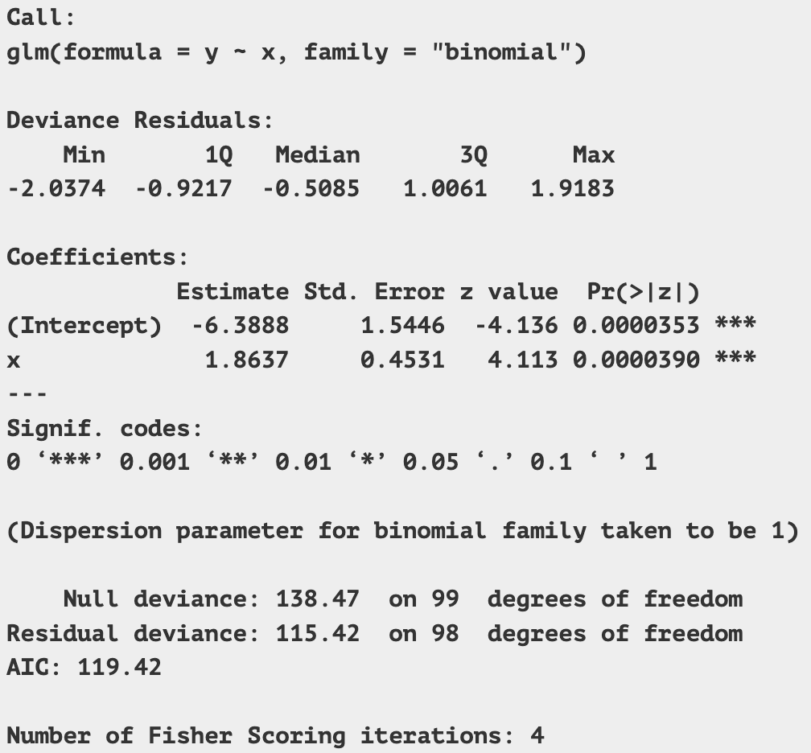
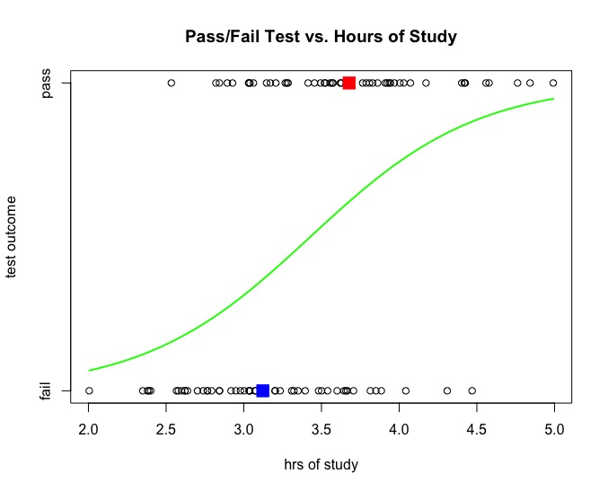
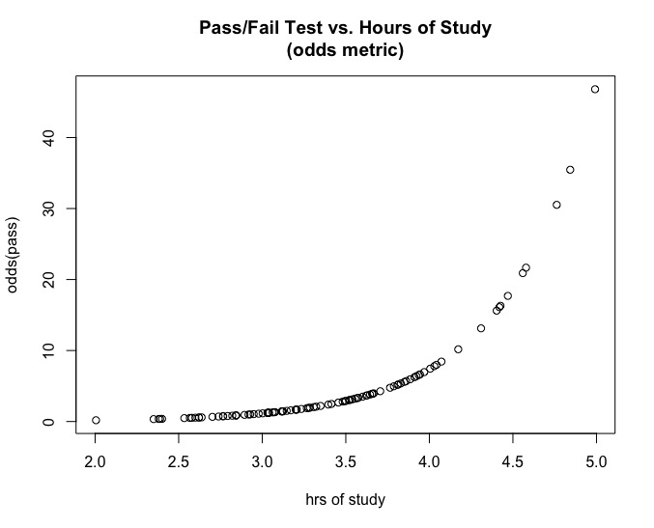
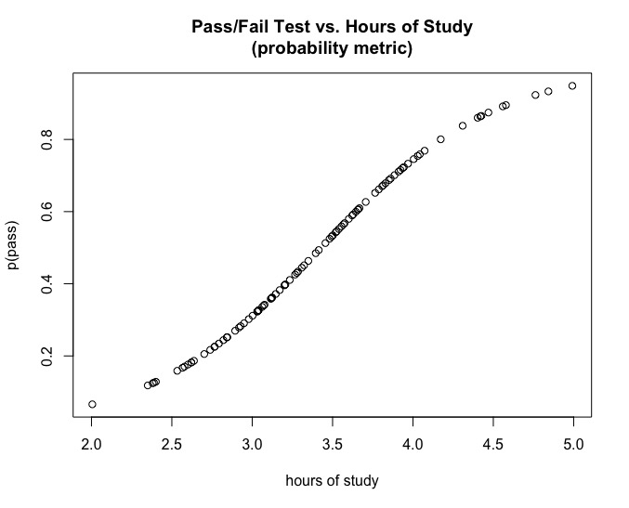

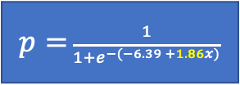

Logistic Regression Coefficients Explained Hours of Study Predicting Pass/Fail Test
A 1-hour change in x
→ same difference in log odds (LO):
4.5 - 3.5hrs = 1.99 - .13 = 1.86 LO 3.5 - 2.5hrs = .13 - (-1.73) = 1.86 LO
log odds
$$ln\left[\frac{p}{1−p}\right]=−6.39+1.86x$$
A 1-hour change in x → same ratio in odds: 4.5hrs/3.5hrs = 7.37/1.14 = 6.45 OR 3.5hrs/2.5hrs = 1.14/.17 = 6.45 OR
odds
$\frac{p}{1−p}$ = $e^{−6.39 +1.86x}$
data
A 1-hour change in x → logistic-curve (nonlinear) change in probability 4.5 - 3.5hrs → .881 - .533 = .347
3.5 - 2.5hrs → .533 - .150 = .383
probability
$p=$ $\frac{1}{1+e^{−(−6.39 +1.86x)}}$
3/12/23 - Feedback welcome!
Fred Oswald, foswald@rice.edu
https://workforce.rice.edu
This work is licensed under a
Creative Commons Attribution-ShareAlike 4.0 International License
Use/modify with attribution - see https://tinyurl.com/BYSA40

